Slide 1
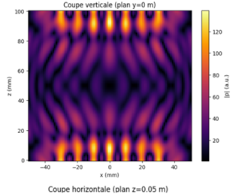
x=0.000m

Slide 2
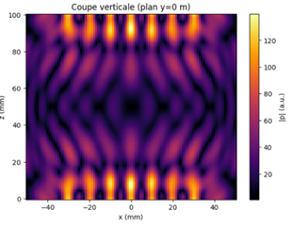
x=0.001m

Slide 3

x=0.002m

Slide 4
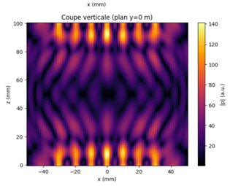
x=0.003m

Slide 5
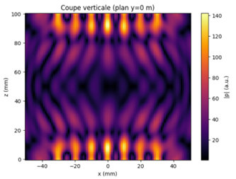
x=0.004m

Slide 6
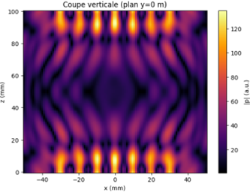
x=0.005m

Slide 7

x=0.006m

Slide 8

x=0.007m

Slide 9
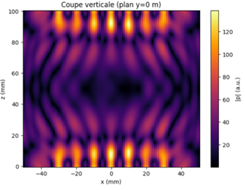
x=0.008m

Slide 10
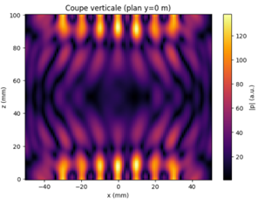
x=0.009m

Slide 11
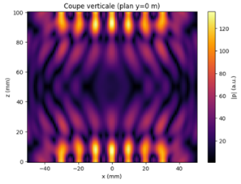
x=0.0010m

Slide 12
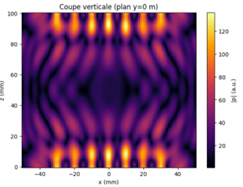
x=0.0011m

Slide 13

x=0.0012m

Slide 14

x=0.0013m

Slide 15

x=0.0014m

Slide 16
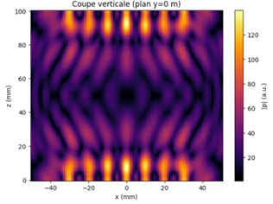
x=0.0015m

Slide 17
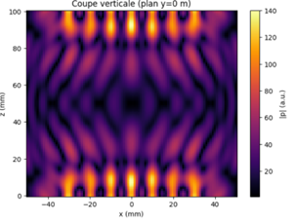
x=0.0016m

Slide 18
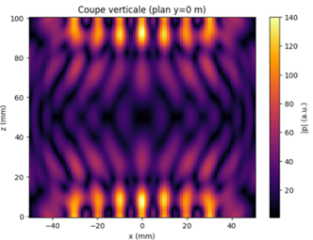
x=0.0017m

Slide 19
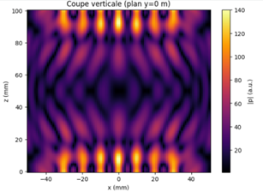
x=0.0018m

Slide 20

x=0.0019m

Slide 21
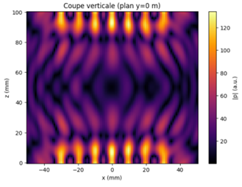
x=0.0020m

Slide 22
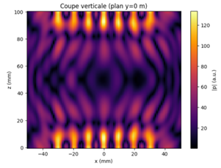
x=0.0021m

Slide 23
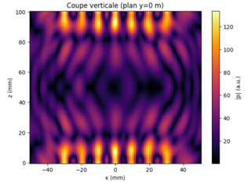
x=0.0022m

Slide 24

x=0.0023m

Slide 25
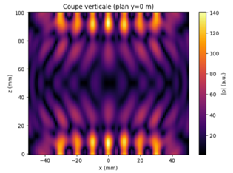
x=0.0024m

Slide 26

x=0.0025m

Slide 27

x=0.0026m

Slide 28

x=0.0027m

Slide 29
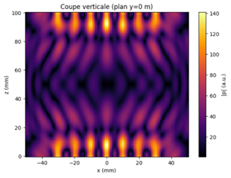
x=0.0028m

Slide 30

x=0.0029m

Slide 31
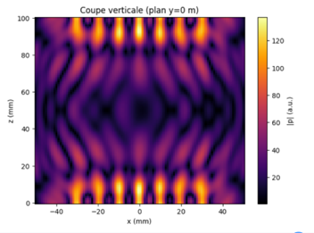
x=0.0030m

Slide 32
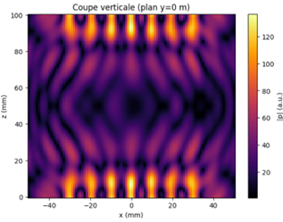
x=0.0031m

Slide 33

x=0.0032m

Slide 34
x=0.0033m

Slide 35
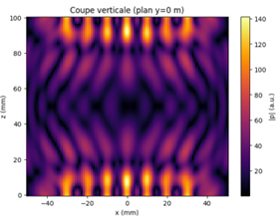
x=0.0034m

Slide 36
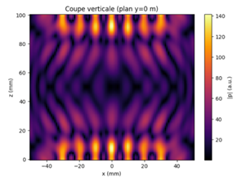
x=0.0035m

Slide 37
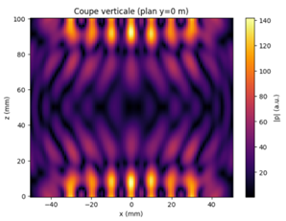
x=0.0036m

Slide 38

x=0.0037m

Slide 39

x=0.0038m

Slide 40

x=0.0039m

Slide 41
x=0.0040m

